Slide 1

Developing with Agile
Michael Duteau

Slide 2

Roles in Agile
Product Owner:
Collects software requirements
Maintains communication with the client
Constructs user stories and product backlog for the project
Scrum Master:
Assures adherence to the agile method principles within the team
Organizes and oversees various Scrum events
Caters to the needs and success of all team members
Testers:
Develop test cases based on user stories that include actions and acceptance criteria
Test and debug written code
Developers:
Write code based on user stories that satisfy the required actions and acceptance criteria that are presented in test cases
Ensure that the code written translates to a useable and secure piece of software

Slide 3
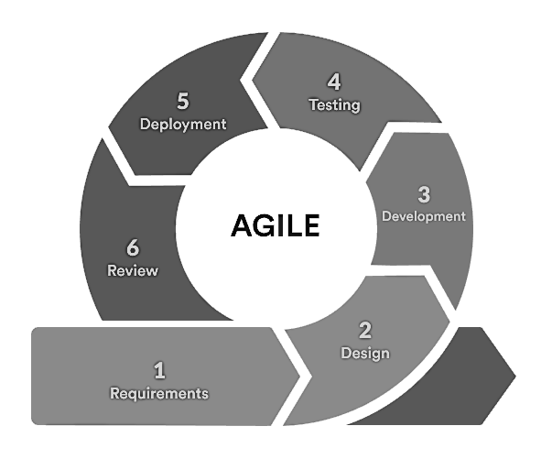
The Agile Software Development Lifecycle
Requirements:
Product Owner will meet with the client and potential end users
Requirements are gathered and product backlog is made
Design:
Requirements are used to construct user stories
User stories are used to construct test cases
Proposed limitations, time frame, and budget are developed
Development:
Developers begin to construct code based on user stories and test cases
At least a portion of useable software is made available by the end of development
Testing:
Testers begin testing and debugging the developed piece of software
Deployment:
The software that is available is now deployed as a useable application that can be presented to the client
Review:
A review of any changes that are requested of the current state of the software takes place before the next iteration
Sprint review and retrospective occur
Notes:
Image source: Anurina, O. (2021). Agile SDLC. MLSDev. Retrieved June 19, 2023, from https://d32myzxfxyl12w.cloudfront.net/assets/images/article_images/925d76d668dc5bf47d44a8fc0907f30d1d9c8b1f.png.

Slide 4


Agile Vs. Waterfall
Agile
Waterfall
Flexible, can easily adapt to changes
Does not require much documentation
The product will develop over multiple iterations
Useable software is available to test early in the process
Does not require intense planning, the project will change and evolve through the iterations
Rigid and strict, changes can be difficult to implement
Requires intense documentation in order to perform effectively
Product is typically expected after only one iteration
Useable software is not available until completion
Requires intense planning in order to succeed; development cannot begin otherwise

Slide 5
References
Anurina, O. (2021, November 12). Agile SDLC: Skyrocketing Your Project with Agile Principles. MLSDev. https://mlsdev.com/blog/agile-sdlc
Charles G. Cobb. (2015). The Project Manager’s Guide to Mastering Agile : Principles and Practices for an Adaptive Approach. Wiley.

Slide 6
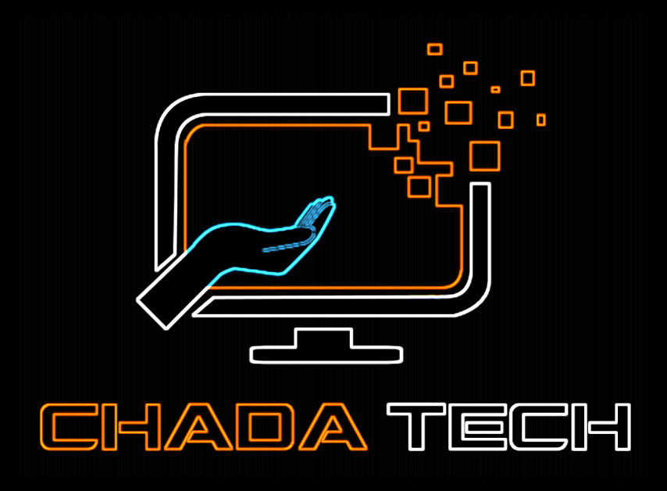
THANK YOU
Michael Duteau

